Slide 1
P1 – KU Leuven Faculty of engineering technology campus De Nayer
Peter Arras

Slide 2
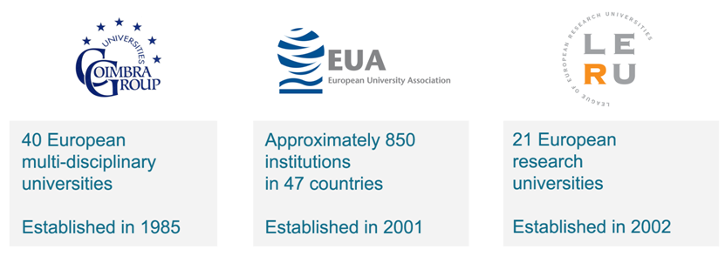
KU Leuven: fact and figures
Founded in 1425, nearly 600 years of university experience
More then 54000 students in 2013-2014
More then 20000 staff members
Member of International networks:

Slide 3
University: fact and figures
54288 students for the academic year 2013-2014
Distribution :
47% Bachelor
33% Master
5% Advanced Master
8.5% Doctoral programme
1% Academic Teacher Training
5% Other

Slide 4
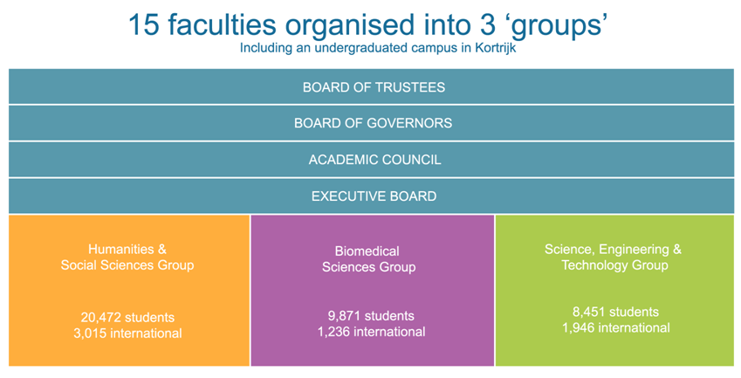
University structure
Faculties:
Sciences
Engineering technology
Engineering sciences
Architecture
Bio-engineering

Slide 5
Faculty/department involved.
Faculty of engineering technology.
Design and production research cluster.
Technology translation to SME’s
Design, materials and production.
MTM (Metallurgy and Materials engineering)

Slide 6
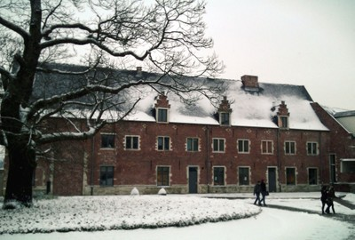
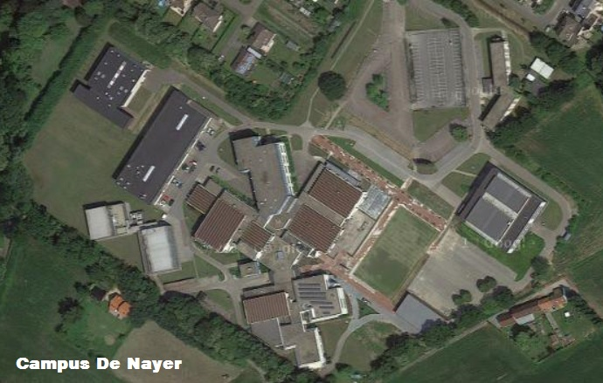
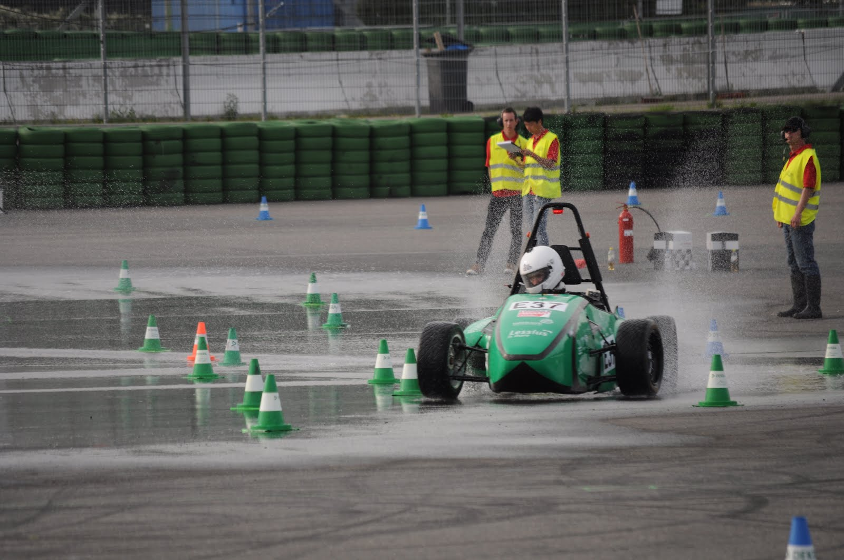
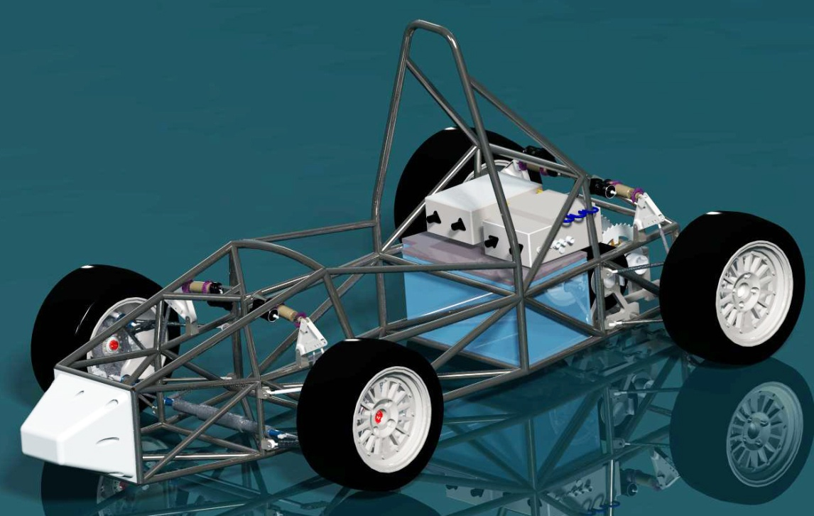
KU Leuven – Faculty of Engineering technology.

Slide 7
Stakeholders:

Slide 8
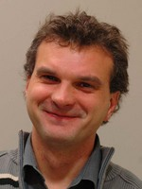
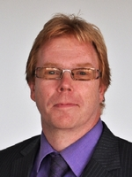
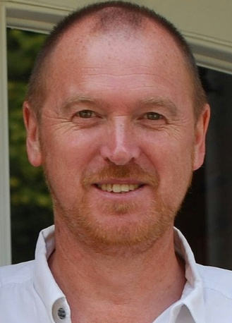
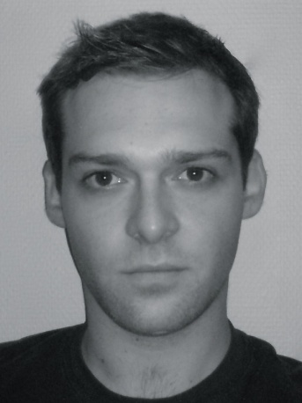
Local project team.
Peter Arras Jan Ivens Chris Peeters Jasper Cerneels

Slide 9
Contacts.
Chris Peeters
lab material sciences
KU Leuven| Faculty of engineering technology
Campus De Nayer
J. P. De Nayerlaan 5
BE2860 Sint Katelijne Waver | Belgium
Tel. + 32 (0)15 31 69 44
Email: chris.peeters@kuleuven.be
Prof Dr Jan Ivens
Vice-dean for research profiling
Prof in material sciences
KU Leuven| Faculty of engineering technology
Campus De Nayer
J. P. De Nayerlaan 5
BE2860 Sint Katelijne Waver | Belgium
Tel. + 32 (0)15 31 69 44
Email: jan.ivens@kuleuven.be
Peter Arras
Contact/coordinator tempus MMATENG
Design techniques.
KU Leuven| Faculty of engineering technology
Campus De Nayer
J. P. De Nayerlaan 5
BE2860 Sint Katelijne Waver | Belgium
Tel. + 32 (0)15 31 69 44
mob. + 32 (0)486 528 196
Email: peter.arras@kuleuven.be

